Slide 1
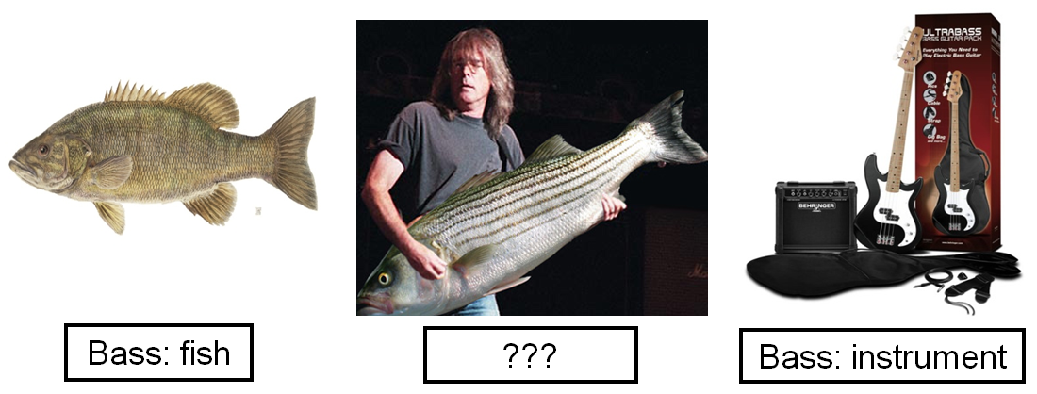
Diachronic Word Sense Change Identification
Ankit Singh 12034
T Raghuveer 12762

Slide 2
Problem Statement
To devise an unsupervised approach to identify words which have changed over time.
Perform the task on multiple epoches in multiple languages. – English, Hindi and Mandarin if possible

Slide 3
Motivation
Time sense disambiguation is highly instrumental in culturonomics.
Important for people working with historical texts, such as librarians, historians and linguists.
It is also helpful to lexicographers and design engineers in a variety of NLP/IR tasks.

Slide 4
Examples
‘Gay’ - Noble person (early 20th century)
- Homosexual (21th century)
‘Artificial’ - positive sense (early 20th century)
- negative sense ( current decade )
‘Sick’ - illness ( 20 & 20th century)
- crazy or cool (21th century)
‘Flirt’ - jerky motion (500 years ago)
- ……………. (21st Century)
‘Bachelor’ - young knight (Long ago)
- University affiliated (21st Century)

Slide 5
Challenges
Dataset Collection
No directly available dataset with diachronic tags
Dataset corresponding to different languages was to be generated
Identify words whose meaning has not changed over time..
.
.
.

Slide 6
Existing Approaches
Adam Jatowt et al. -
Sunny Mitra et al. - Chinese Wiskers over a co-occurence vectors from distributed thesuraus, then compare clusters for birth, death, merge or split.
Haim Dubossarsky et al. -

Slide 7
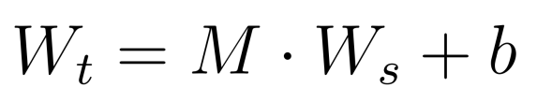




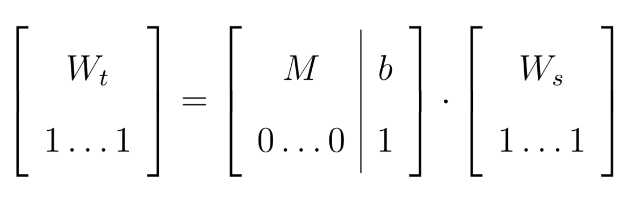
Our Approach
Adapted from thesis of Shashwat Chandra.
Used to transform and align vectors trained on two different datasets
- transformed word vector
- transformation matrix (train.set1 to train.set2)
- word vector from first set
- bias term for translation

Slide 8
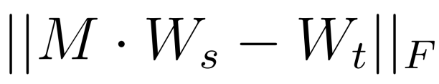
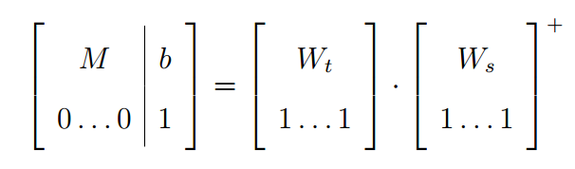

Our Approach ..
M and b ??
Use words whose meaning has not changed over the two datasets and find an estimate
minimize
Least square solution helps

Slide 9
Our Problem fits

Slide 10
Results

Slide 11

Thoughts

Slide 12
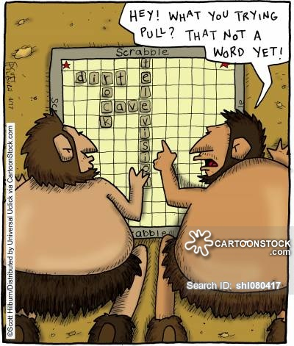

References

